Slide 1
Notes:
Front Cover Slide

Slide 2
Change Leads to Success
Sector-Driven Customized Training Solutions
Cathy Clower and Darline Graham
Notes:
Today we are going to discuss how a system change led to a customized training initiative and provided opportunities for VR consumers.

Slide 3
Introduction
Change Leads to Success

Slide 4
Change in System
Customized Training
Success
Notes:
We will discuss in detail how WIOA strengthened our alignment with partners and led to us becoming part of the sector strategies approach.
We will also talk about how being part of this new approach to workforce development led to a customized training initiative that has resulted in successful employment for VR consumers.

Slide 5
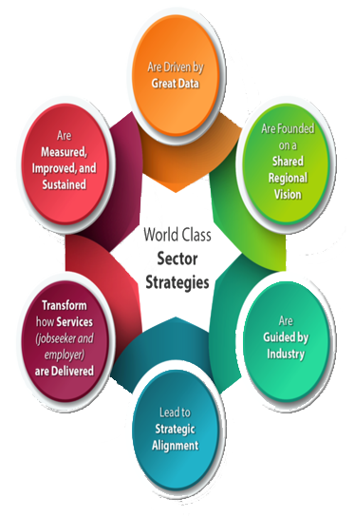
WIOA Increases Collaboration to meet the needs of job seekers and employers
SC partners align to meet the needs of industry
VR joins Sector Strategies teams across South Carolina
Notes:
First, let me provide you with a little background on how this change occurred. As you all know the Workforce Innovation and Opportunity Act increases collaboration between workforce development partners to ensure partners provide coordinated and complementary services allowing job seekers to more easily acquire the skills, training and credentials needed to meet employer requirements.
This emphasize on collaboration allowed us to be part of the Sector Strategies approach which encourages partners to work more closely together to meet the needs of industry.
As part of Sector Strategies, the state was divided into four regions with a VR representative on each team. The goal of these teams was to identify growing industry in each region so that we could pull together resources from all partners in order to develop an expanded pipeline of talent to better meet employer’s needs.

Slide 6

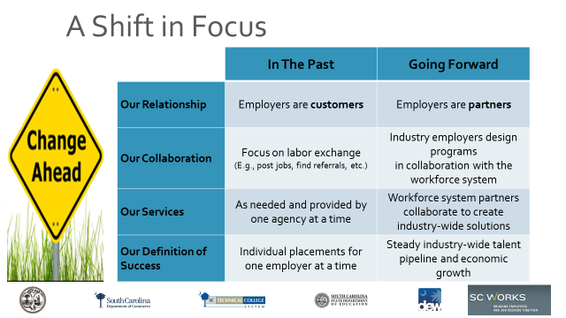
A Shift in Focus
 | In the Past | Going Forward
Our Relationship | Employers are customers | Employers are partners
Our Collaboration | Focus on labor exchange (e.g., good jobs, find referrals, etc.) | Industry employers design programs in collaboration with the workforce system
Our Services | As needed and provided by one agency at a time | Workforce system partners collaborate to create industry-wide solutions
Our Definition of Success | Individual placements for one employer at a time | Steady industry-wide talent pipeline and economic growth
Notes:
Here you see a diagram that explains how the Sector Strategies approach shifted our focus. Sector strategies emphasizes expanding workforce partners to also include businesses.
This means we now also see employers as partners who help us design our services to meet industry needs.
While we will remain focused on providing quality individualized services to VR consumers, we have increased our efforts to collaborate with our workforce and business partners to provide an expanded and steady talent pipeline to create industry-wide solutions.

Slide 7
New Approach to Talent Fairs
Change Leads to Success

Slide 8

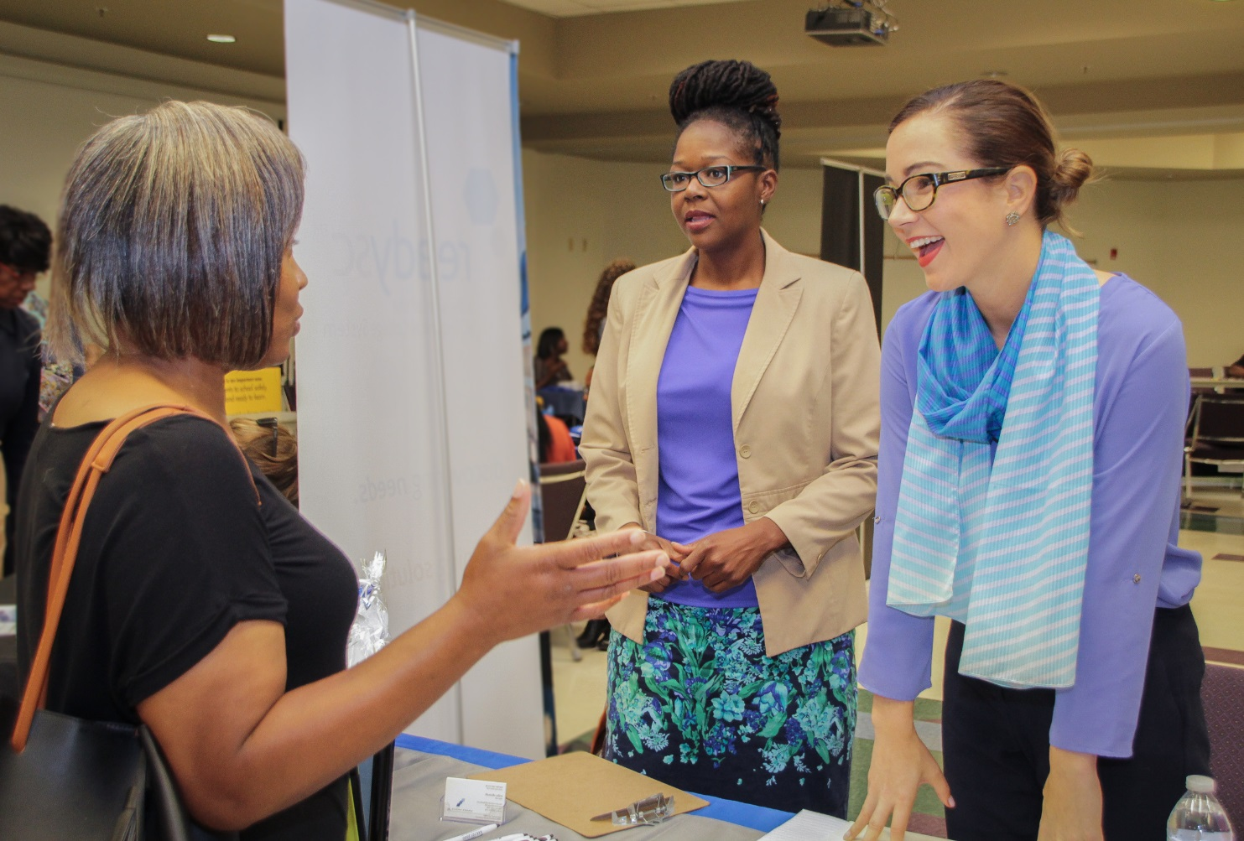
Talent Fairs allowed us to….
focus on in-demand sectors
match vocational objectives and training to the needs of industry
build customized training initiatives
scvrd.net
Notes:
By understanding that an employer’s time is valuable, a sector strategy approach was taken in making a change from holding job fairs to the use of talent fairs.
To better explain what we mean by talent fairs, I will share an example. In this particular example, we wanted to focus on one of the in-demand sectors in the Upstate region, which was Business Services. With our Business Applications Plus training that prepares consumers for careers in customer service and office support, including Business Communications, we felt we could provide well-prepared candidates to increase the pipeline of talent for that industry.
So the Talent Fair focused on having employers attend from the Business Services Industry and having VR Consumers attend with Vocational Objectives and training that matched that industry.
One business in attendance, BPO American (a local call center) was extremely impressed with several qualified candidates presented to them at the Fair. In this streamlined, more focused approach, they were also able to share, in detail, their needs for additional individuals with customer service training/experience.
As a result we were able to develop a partnership that led to a customized training initiative.

Slide 9
Customized Training
Change Leads to Success
Notes:
Now we will discuss the customized training that resulted from the Talent Fair…..

Slide 10
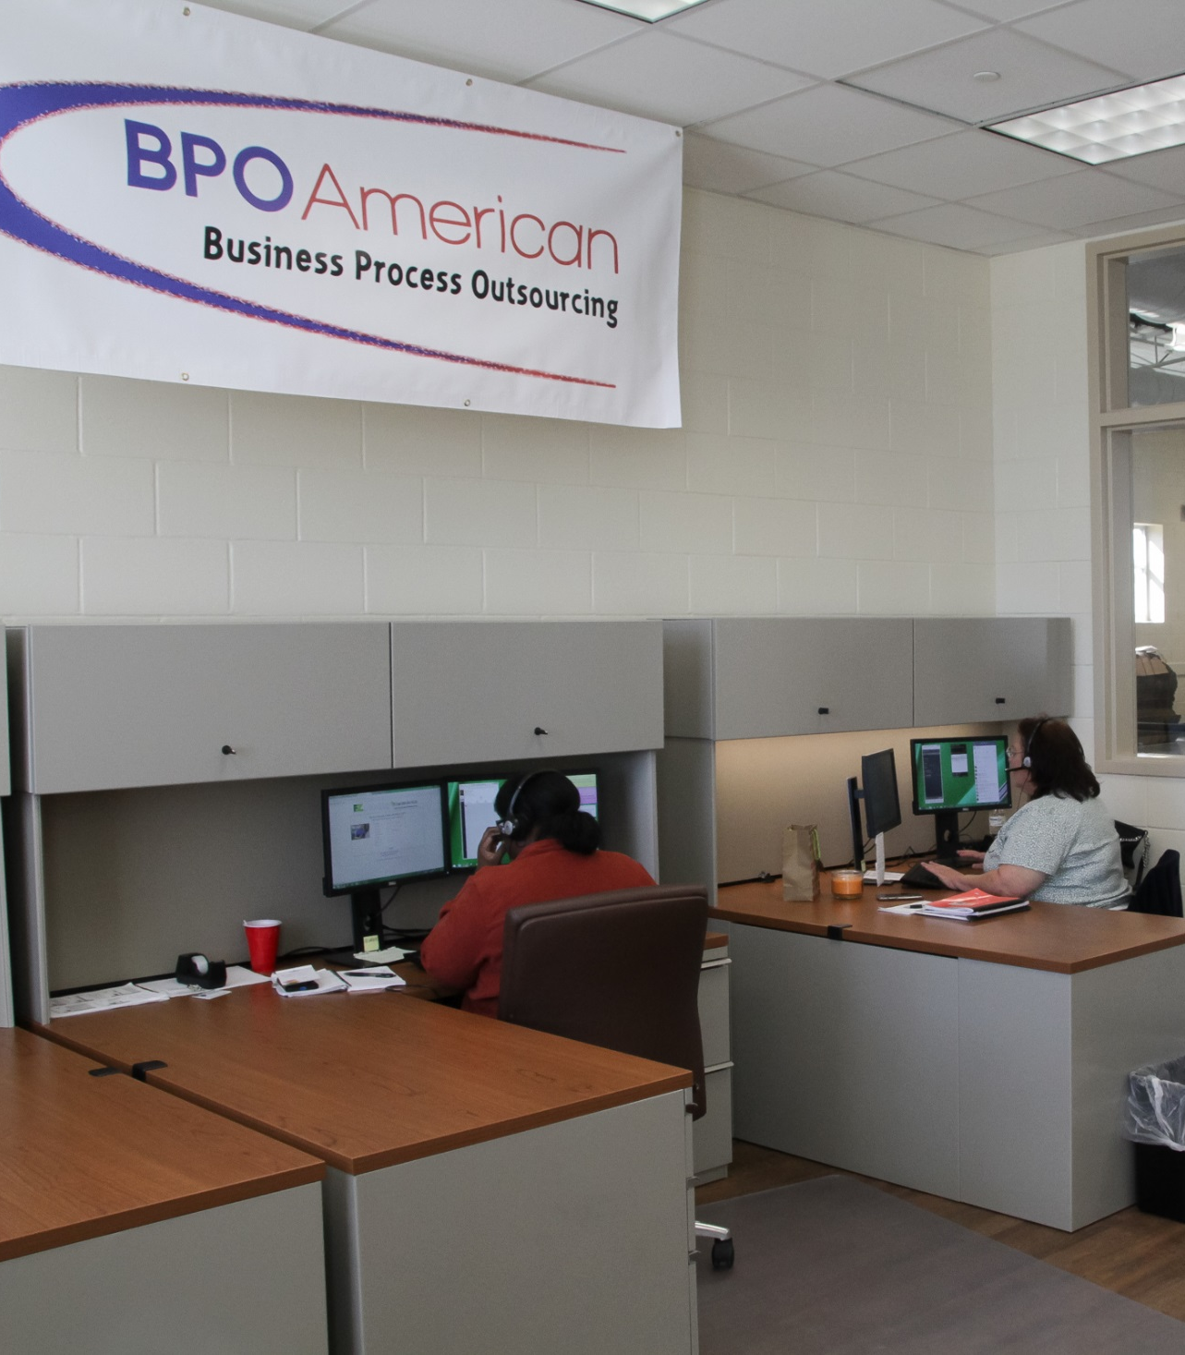
The training was developed according to industry needs
Training can be modified based on Consumer’s needs
Previous experience and/or training determines where they begin and how long they participate
scvrd.net
Notes:
A mock mini call center was set-up in our Lyman Training Center that not only provides VR Consumers with helpful skills, but provides a pipeline of talent to BPO American and other companies in the area who are in need of Customer Service representatives.
Before they enter the call-center training, we determine the level of preparation that may be needed. If an individual has very little prior customer service training or experience, we provide basic computer skills, soft-skills, and customer service training in-house through our Business Applications Plus program.
Some individuals with previous call center training or experience can enter directly into the hands-on call center portion of training.

Slide 11


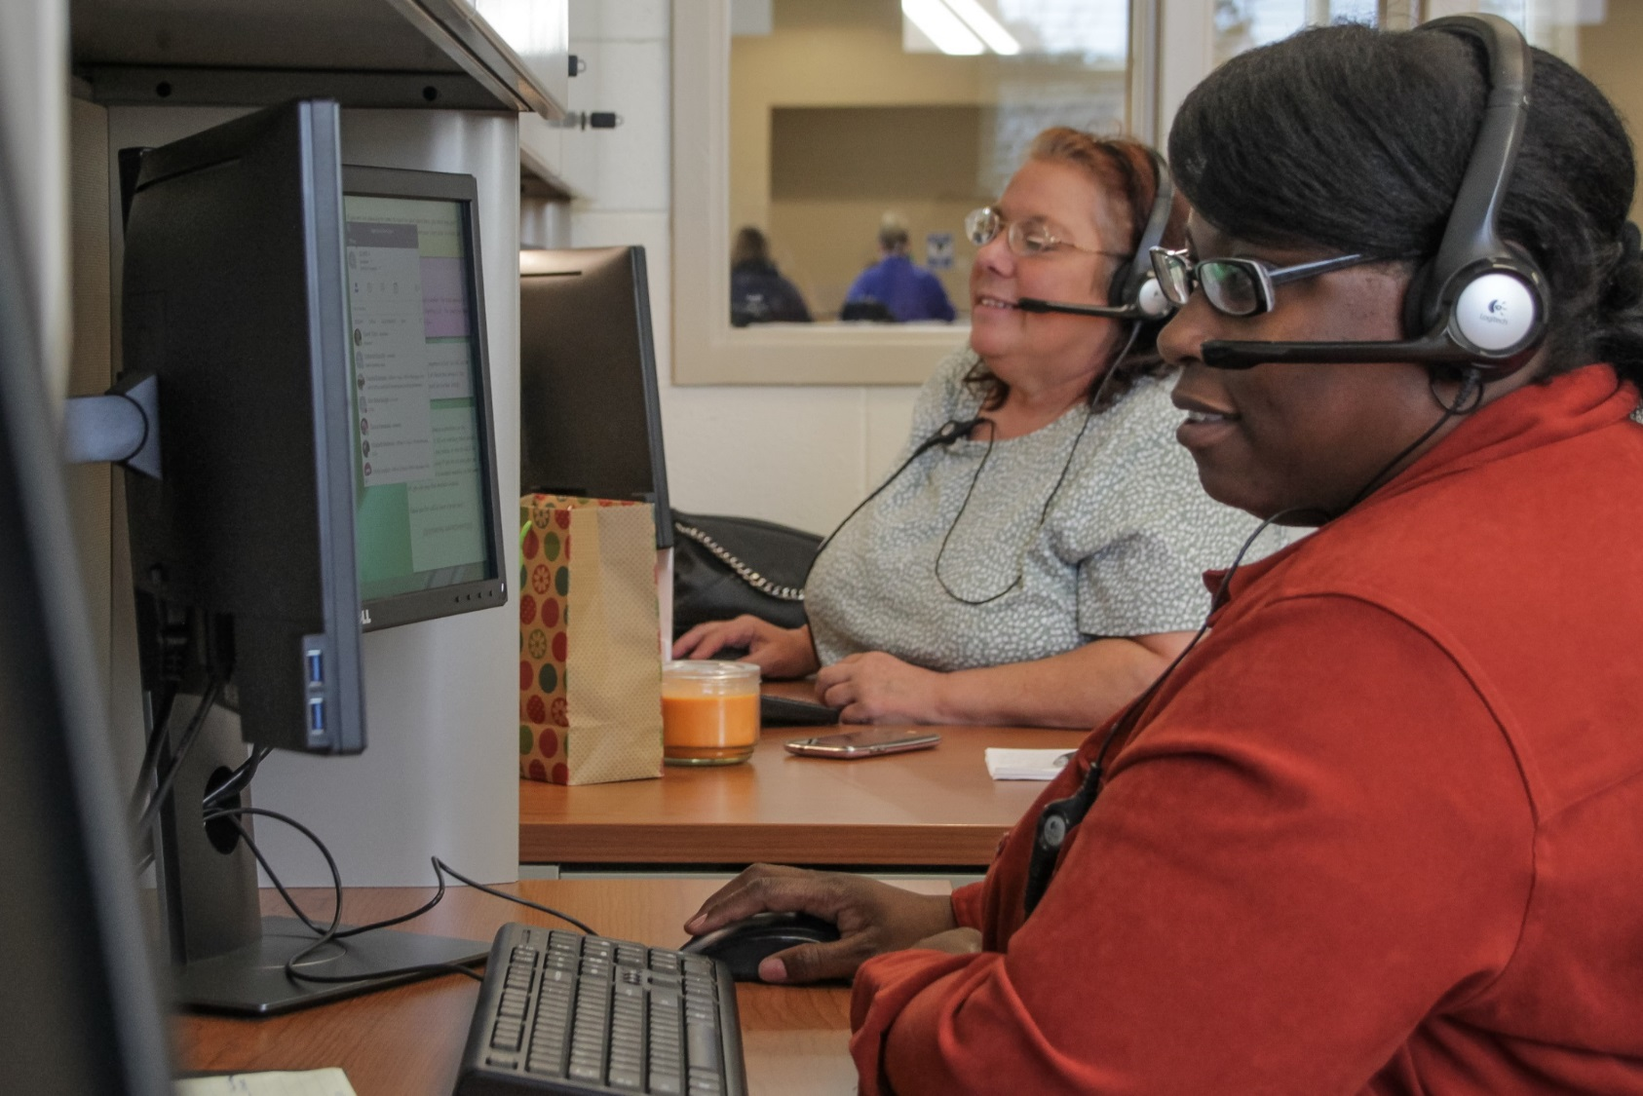
Trainees utilize “live calls”
BPO American provides an on-site trainer
Trainees progress in call volume, leads to hire
scvrd.net
Notes:
When in the hands-on call center portion of the program, they are trained first on mock calls from trainers calling in from BPO American and then “real calls” are slowly mixed in.
When the trainers feel the trainees are ready they begin receiving mostly live incoming calls which vary depending on the needs of the company.
Consumers receive calls to make reservations, pay traffic tickets, and relay messages to medical offices.
As training advances, the trainees variety of calls and volume increases.
The program is very individualized based on consumer’s progress and needs, so there is no set amount of time, but typically training averages 8 -16 weeks.
When BPO has opportunities available or openings with other companies are identified and the trainee has proven successful, an interview will be scheduled.

Slide 12
Results
Change Leads to Success
Notes:
And now to the most important part, Success!

Slide 13
Success:
More than 15 Consumers have participated in training.
Hires include:
BPO American 4
Sitel 3
TD Bank Customer Service 1
Visiting Angels Home Health Care 1
Home Instead Home Health 1
Notes:
The training initiative has been very successful.
As you can see here, we have had a few that did not complete the program, mostly due to disability related issues, but for the most part we have had great success with the customized training initiative.
Since fall 2017 when the initiative began we have had 10 VR consumers that have entered into Customer Service jobs providing them with excellent career opportunities and filling the needs of industry in the upstate region of our state.
Overall, the partnership provides a talent pipeline for customer service positions to meet this industry’s needs, and provides VR consumers with good paying jobs and benefits.
We are excited to hopefully see this program grow and lead to many more successes.

Slide 14
Successful Case Study
A 42 year old female was referred by SC Works; a
workforce partner. She was having difficulty with her
legs and hands due to MS and had last worked in
2002. After assessments and attending both occupational
and physical therapy, the consumer entered Job Readiness
Training. This training served to build stamina and provide
foundational skills. Next she participated in a Job Try Out
for the local Chamber of Commerce as a receptionist. She
quickly learned she had an interest in customer service, so
she entered VR’s Basic Applications Plus training that teaches
advanced skills necessary for administrative, clerical, and
customer service positions. After successful completion of this
program, she was identified as a good candidate for VR’s
call center training. At the end of her first week in the mock call
center, she said, “I love It!” She completed 12 weeks of onsite
call center training, received an interview, and was hired in a full
time position. She has been with BPO American since January
and is still happy.

Slide 15
Cathy Clower and Darline Graham 803-896-6668 www.scvrd.net
Notes:
Thank you! Are there any questions?

